Slide 1

DEPI Generative AI: Text Generation Model
Group Members:
Shahd Mohamed
Fady Boktor
Abdalla Ibrahim ​

Slide 2

Project Description
We have built a generative AI text generating model which supports users with quick accurate responses using the right prompts. The model has been trained and tested utilizing cleaned and processed using cleaned and pre-processed wiki text data. The code below has been written on google Collab with python.

Slide 3

Project IMPACT
The model is meant to serve the community in reaching faster to the accurate required information saving time. Quick and accurate information savings has much more impact beyond time savings (e.g. Economical and Financial Impact).

Slide 4
Project Breakdown:
The section below outlines the steps involved in fine-tuning a pre-trained GPT-2 language model on the WikiText-2 dataset and defines the architecture for a basic text-generating using PyTorch.

Slide 5
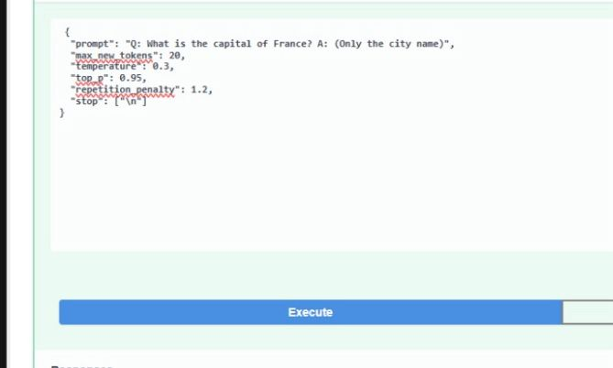
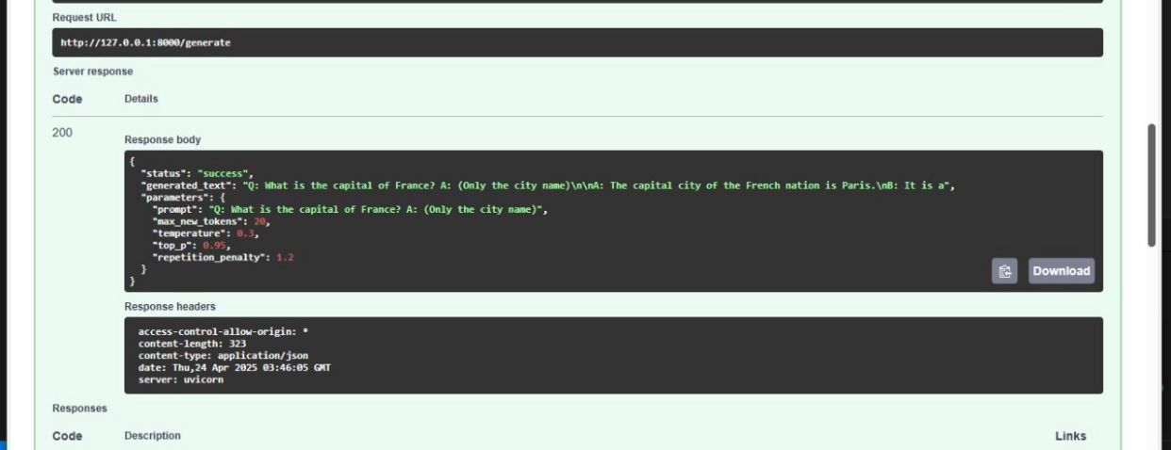
Product Overview
Deployment and results
Environment Setup and Libraries installation
Splitting Data and fine tuning GPT2 model
(Training and testing)
Loading and preprocessing Dataset

Slide 6


Environment Setup and Libraries Installation:
This section of code is responsible for installing and setting up the required libraries for the project. It uses pip, the package installer for Python, and python -m, which runs a library module as a script.

Slide 7

Loading and Preprocessing Data:
This section takes a raw text dataset, cleans it, performs NLP preprocessing (tokenization and lemmatization), and then tokenizes it specifically for the GPT-2 model. The final output, tokenized dataset, is ready to be used for training or fine-tuning a GPT-2 model. ​​

Slide 8

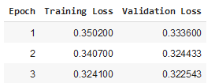
Splitting Data and Fine Tuning gpt- 2 Model:
Splitting Data:​
splitting the pre-processed dataset into two parts: (80%) one for training the model (train_data) and (20%) one for validating its performance during training (val_data).
Fine Tuning:
Libraries and Setup
Data Preparation
Training Arguments
Creating and Training the trainer
Saving the Fine-Tuned Model
Checking Training Results

Slide 9
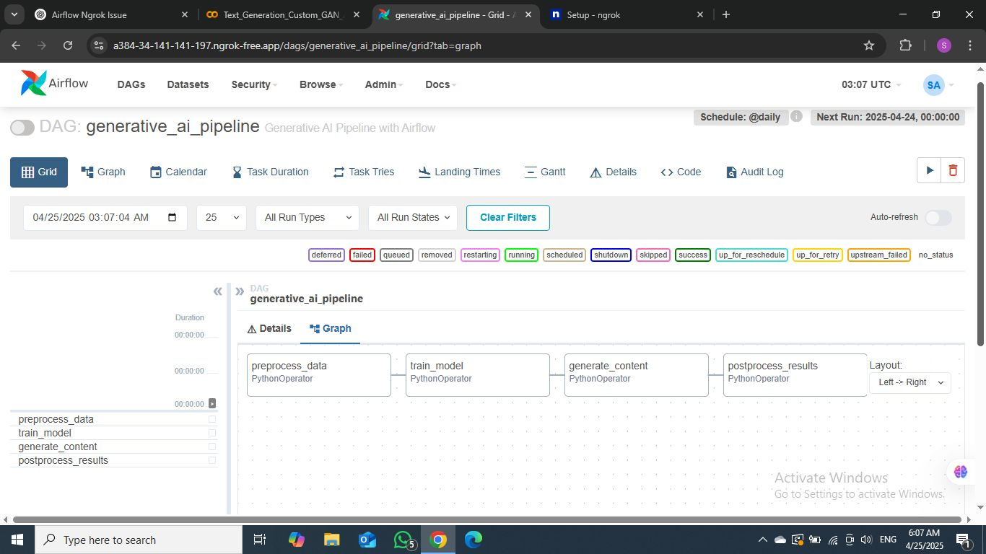
Apache Airflow content generation:
Apache Airflow automates and manages workflows in the content generation pipeline, ensuring tasks run in the right order and on time.
Automates Task Scheduling: Runs tasks like data scraping, preprocessing, and model training at scheduled intervals.
Workflow Orchestration: Defines task dependencies as Directed Acyclic Graphs (DAGs) to ensure smooth execution
Monitoring: Tracks task status and provides real-time error handling.
Scalable and Flexible: Easily scales to handle larger datasets and more tasks.
Seamless ML Integration: Automates model retraining and content generation.

Slide 10

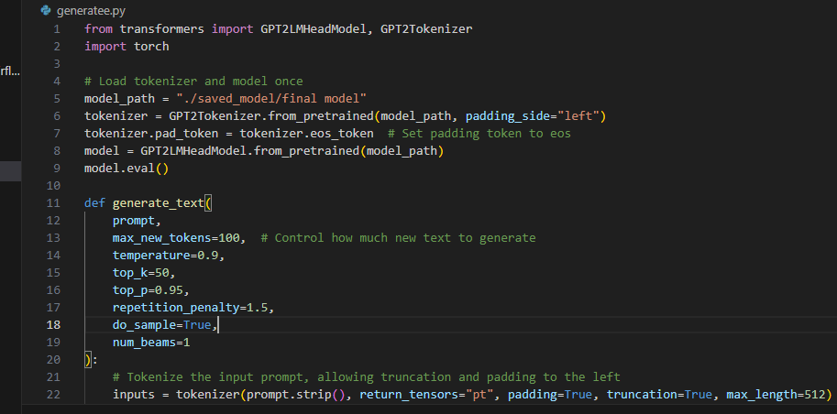
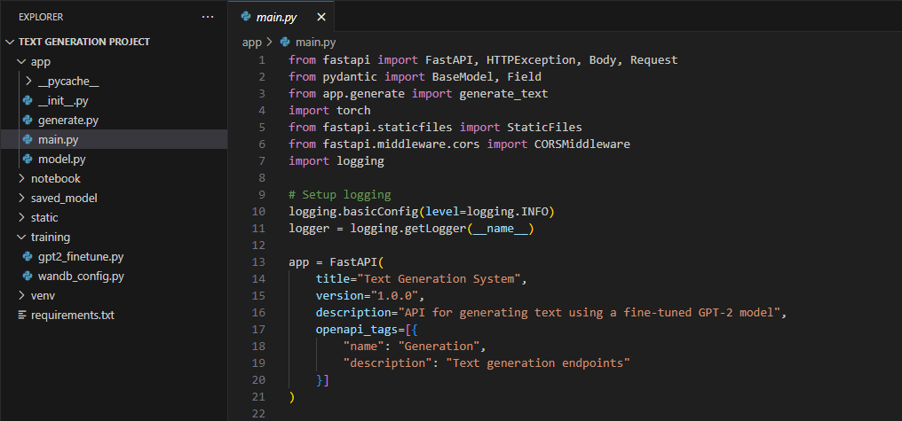
DEPLOYMENT and Results
We have deployed a text generation model using FastAPI, enabling us to generate text from a prompt through an API.

Slide 11
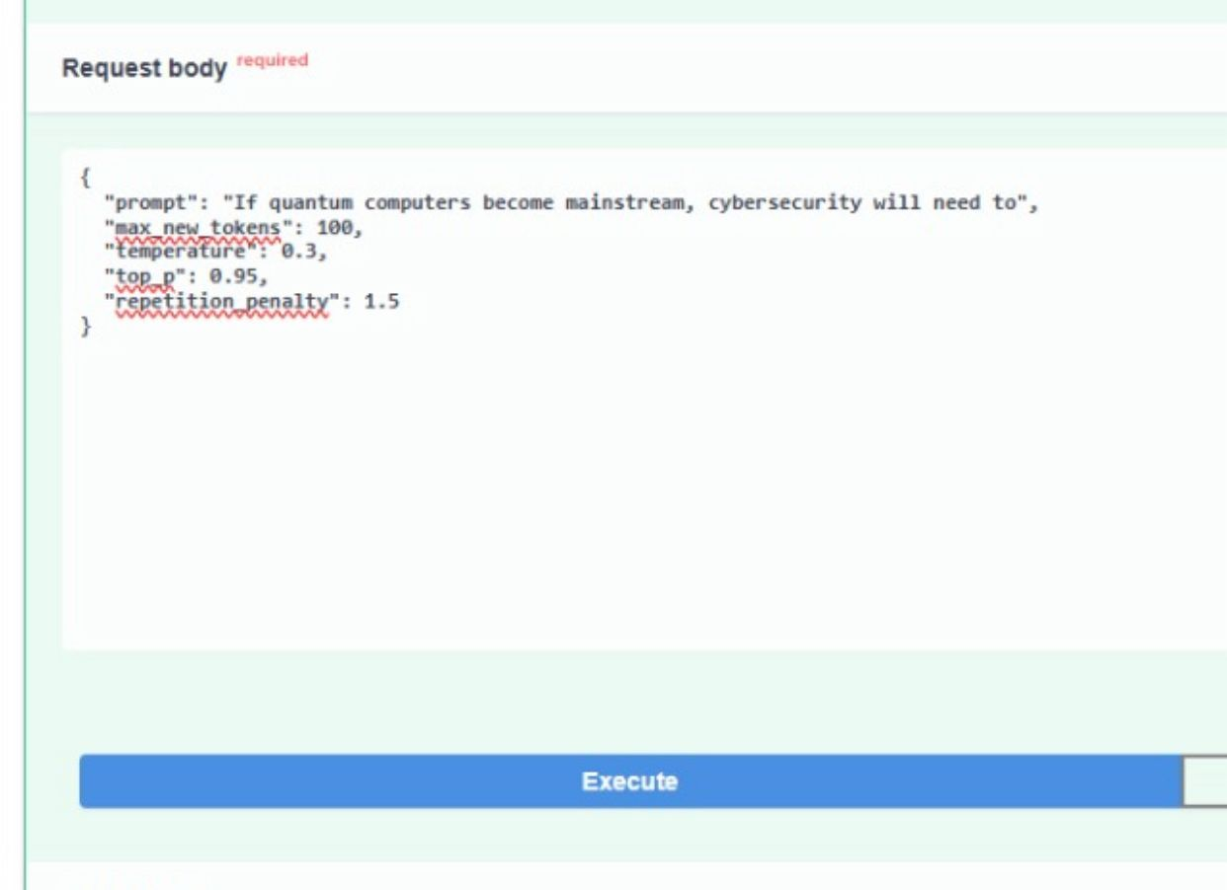
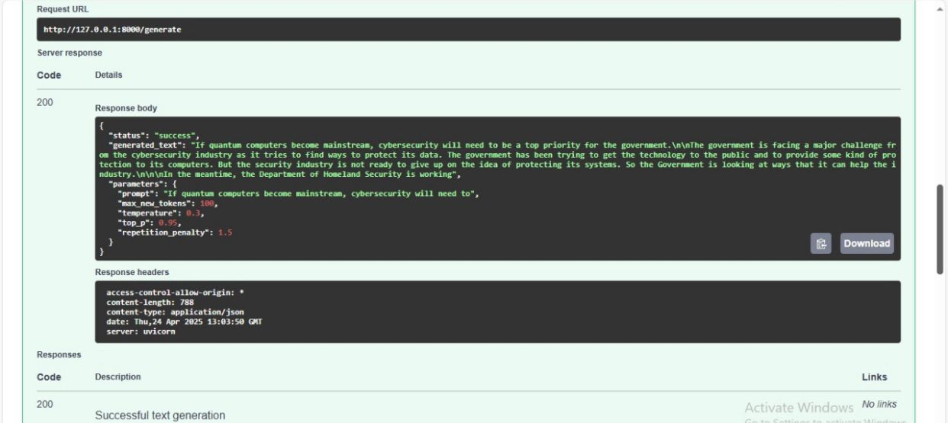
DEPLOYMENT and Results

Slide 12

Thank you

